Slide 1
DIGITAL LOGIC · DEPARTMENT OF CSE
DESIGN AND SIMULATION
OF ADDER AND SUBTRACTOR
USING LOGISIM
A gate-level path from binary equations to observable 0/1 signals.
TEAM MEMBERS + COLLEGE IDS
2620030483_Rithvik
2620030486_Bavesh
2620030484_ Rithwik Patrudu
2620030488_ Sravani reddy
2620030411_ Sahasra Dhanalakoti
DEPARTMENT
Department of CSE
LOGISIM
DESIGN
STUDY

Slide 2

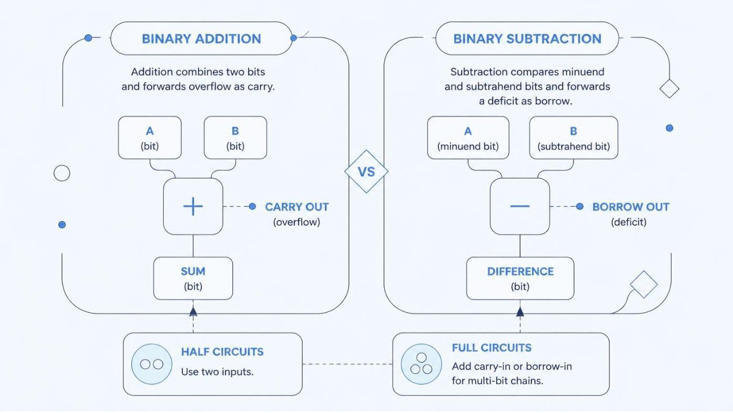

FOUNDATION · BINARY ARITHMETIC
BINARY ARITHMETIC STARTS WITH TWO SIMPLE OPERATIONS
Addition
Subtraction
Combine two bits and pass any overflow forward as carry.
Compare the minuend and subtrahend, passing any deficit forward as borrow.
Building blocks
Half circuits take two inputs; full circuits add Cin or Bin for wider operands.
The design goal is one correct result bit—and the carry or borrow needed by the next stage.

Slide 3
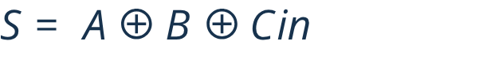

CORE CELL · FULL ADDER
A FULL ADDER ADDS THREE ONE-BIT INPUTS
A, B, and carry-in Cin produce Sum S and carry-out Cout.
A | B | Cin | S | Cout
0 | 0 | 0 | 0 | 0
0 | 0 | 1 | 1 | 0
0 | 1 | 0 | 1 | 0
0 | 1 | 1 | 0 | 1
1 | 0 | 0 | 1 | 0
1 | 0 | 1 | 0 | 1
1 | 1 | 0 | 0 | 1
1 | 1 | 1 | 1 | 1
EQUATIONS · GATE-LEVEL FLOW
Inputs: A, B, and carry-in Cin. Outputs: Sum S and carry-out Cout.
Gate-level flow: XOR A and B, XOR that result with Cin, then combine the carry paths with AND and OR gates.
Multi-bit use: chain Cout into the next stage's Cin to cascade for wider operands — the Logisim Adder component exposes both pins.

Slide 4
CORE CELL · FULL SUBTRACTOR
A FULL SUBTRACTOR TRACKS DIFFERENCE AND BORROW
FULL-SUBTRACTOR TRUTH TABLE
SIGNAL CONTRACT
Inputs
A | B | Bin | D | Bout
0 | 0 | 0 | 0 | 0
0 | 0 | 1 | 1 | 1
0 | 1 | 0 | 1 | 1
0 | 1 | 1 | 0 | 1
1 | 0 | 0 | 1 | 0
1 | 0 | 1 | 0 | 0
1 | 1 | 0 | 0 | 0
1 | 1 | 1 | 1 | 1
A, B, and borrow-in Bin.
Outputs
Difference D and borrow-out Bout.
Two XOR stages form the difference; NOT, AND, and OR gates create the borrow conditions. When Bout = 1, this bit borrows from the next higher bit.

Slide 5
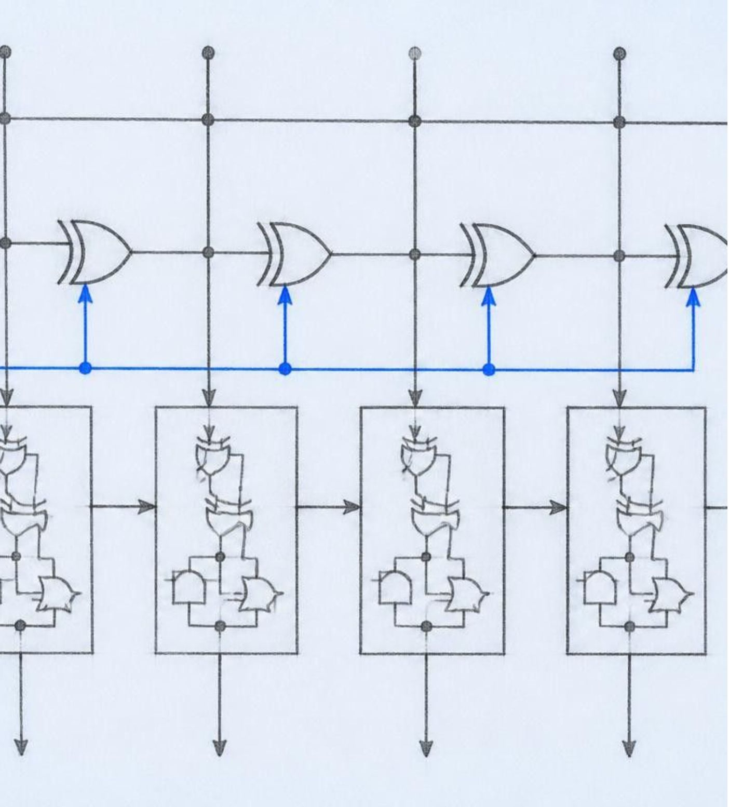

COMBINATIONAL DESIGN · MODE CONTROL
ONE MODE SIGNAL CAN TURN THE CIRCUIT INTO AN ADDER OR SUBTRACTOR
THE CONTROL IDEA
Mode M: M = 0 selects addition; M = 1 selects subtraction.
Operand control: XOR each B bit with M, producing B′ = B ⊕ M.
Carry/borrow control: set the first carry-in, Cin = M.
Result: the same full-adder chain computes A + B (M = 0) or A + two’s-complement B (M = 1).
Logisim build: Input Pins for A, B, M; XOR gates on the B path; an Adder or full-adder chain; LEDs/Probes for result and carry.
Expected checks: toggle M and inputs; confirm the LEDs match the truth tables.
Logisim-evolution is educational software for designing and simulating digital logic circuits; its arithmetic library includes both Adder and Subtractor components.

Slide 6
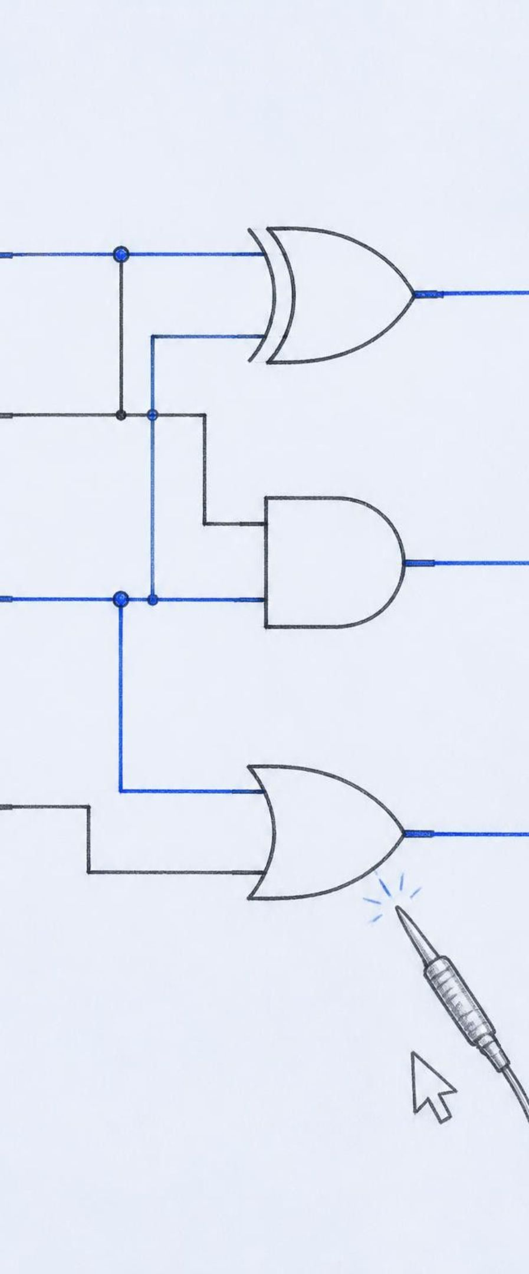
LOGISIM WORKFLOW · VERIFICATION
SIMULATION MAKES THE LOGIC VISIBLE AND TESTABLE
Open a new circuit; place input components, gates or arithmetic blocks, and output probes/LEDs.
Wire inputs to outputs; label A, B, M, S/D, and carry/borrow.
Use the Poke tool to toggle inputs and observe each 0/1 signal in real time.
Record cases: 0 + 0, 1 + 1, 0 − 1, and a mode change: add to subtract.
CONCLUSION
Logisim’s documented workflow is to place inputs, add a gate, connect wires, add a Probe or Lamp, and toggle inputs to observe the result. The library also provides Pin, Probe, Wiring Tool, gates, Adder, and Subtractor components.
Conclusion: the design is correct when the observed Sum/Difference and carry/borrow outputs agree with the equations and truth tables.

